Slide 1
COVID-19 Educational and Childcare Settings
Delivered by the South West Health Protection Team
Information correct on 11th Aug 2020

Slide 2
What we will cover today
Recap on infection prevention principles
Scenarios to illustrate this
Key resources
This does not replace national guidance which is updated regularly. Please check online for the most recent guidance

Slide 3
1. Recap of infection prevention

Slide 5
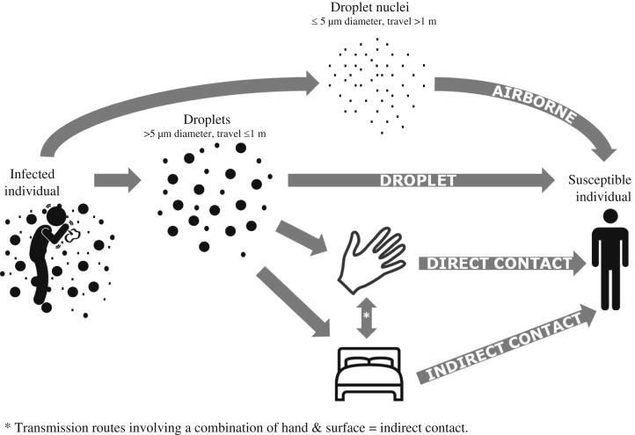
Droplet transmission routes
Notes:
Droplets < 5um can:
*enter the airways
•can reach deep lung
•may remain suspended in air
order of production of highest prevalence of large particles is
•coughing
•speaking
•breathing
•based upon ejection velocity
•speaking droplets can reach 2-10 m/s (<1m range)
•coughing 10-20 m/s (<2m range)

Slide 6
Five key principles
3. Clean! Clean! Clean!
4. Reduce mixing and maximise distancing
2. Wash your hands!
Catch your coughs!
5. Engage with
Test and Trace
Stay at home if ill
or a contact
All of these measures help to prevent the spread of infection and will therefore protect staff and children
Notes:
Notes to presenters
Wash your hands- on entering and leaving school, before eating, after coughing/ sneezing/ blowing nose, after using toilet, after touching- increased frequency and increased vigilance. Ensure that sufficient handwashing facilities are available. Where a sink is not nearby, provide hand sanitiser in classrooms and other learning environments
Cleaning- reduced virus in the environment and therefore reduces the chance of virus spreading to people- clean frequently touched surfaces regularly and more frequently than you would normally. E.g. such as toys, books, desks, chairs, doors, sinks, toilets, light switches, bannisters
Small numbers: no more than 15 children and 1-2 staff per group, smaller numbers reduces the likelihood of transmission
Avoid / reduce mixing: staggered communal activities like meal times, breaks, staggered and managed drop off and pick up, one way systems within the school….
Declutter= less clutter means it is easier to clean. Avoid sharing- sad to do this as we encourage children to learn to share. But in this situation, we need to reduce the use of shared equipment. Also remove things that can’t be easily cleaned e.g. soft toys, soft furnishings

Slide 7
Principles
People with symptoms = possible case
Isolate- do not come to setting!
Get tested- NHS portal/ 119
People with a positive test = confirmed case
Isolate the case
Contacts isolate for 14 days
Incubation Period =
time between exposure to the virus and developing symptoms
= up to 14 days (most likely shorter)
Infectious period = from 48 hours prior to symptom onset (or date of swab) to 10 days after
Notes:
CONTACTS ISOLATE FOR 14 DAYS – whether they get a negative result or not.
POSSIBLE CASES- GET TESTED
If case remains unwell and has symptoms of COVID need to assess the case/ situation= ?False negative test
COVID negative- still ill- fever free 24 hours and recovered- that will cover flu, continued cough not a problem
Boarding school/ special school – we can organise flu testing via Jo.
COVID positive- 10 days isolation- Continue to isolate until 48 hours fever free
ISOLATION IF POSITIVE TEST: If you are not experiencing symptoms but have tested positive for COVID-19 you also must self-isolate for at least 10 days, starting from the day the test was taken. If you develop symptoms during this isolation period, you must restart your 10-day isolation from the day you develop symptoms.

Slide 8
A few definitions!
Case (possible vs confirmed case)
COVID-19 Case Definition: (as of 18/05/20)• A high temperature• A new, continuous cough•
A loss of, or change to, your sense of smell or taste
Contact
1. Direct close contacts: Face to face contact with a case for any length of time within 1m
eg being coughed on, a face to face conversation, unprotected physical contact (skin to skin)
This includes exposure within 1 metre for 1 minute or longer
2. Proximity contacts: Extended close contact (within 2m for more than 15 minutes) with a case
3. Travelled in a small vehicle with a case
Household of CONTACTS do not need to isolate
Outbreak
2 or more CONFIRMED cases in the same group or class
Cluster
2 or more confirmed cases among students or staff in the same setting within 14 days
Notes:
Outbreak suggests spread of infection within the school
Cluster- more likely to be community spread
A case is defined as ……
An outbreak is defined as …….
Outbreak definition
“Two or more confirmed cases of COVID-19 among students or staff who are direct close contacts, proximity contacts or in the same cohort or ‘bubble’* in the school/college within 14 days”.
* a cohort or ‘bubble’ might be a class, year group or other defined group within the school/college. This definition aims to distinguish between transmission occurring in the community versus transmission occurring within the school/college setting.
Cluster definition
“Two or more confirmed cases of COVID-19 among students or staff in a school/college within 14 days”
or
“Increase in background rate of absence due to suspected or confirmed cases of COVID-19 (does not include absence rate due to individuals shielding or self-isolating as contacts of cases)”.
It’s really important to isolate suspected cases early
This helps to prevent the spread of infection within the school

Slide 9
PPE
Cleaners: gloves and aprons
Accompanying/ caring for suspected/ confirmed case: gloves, aprons, masks +/- eye protection
Risk assess need for eye protection: Splashes? Coughing? Vomiting? Spitting?
Safe removal of PPE and thorough handwashing after removal
Notes:
• As a minimum, disposable gloves and aprons should be worn during cleaning.
• Adults who accompany/ care for a suspected or confirmed child in isolation and coming within 2 m distance of the child should wear gloves, aprons and masks.
• .
• If a risk assessment of the setting indicates that a higher level of virus may be present (for example, where unwell individuals have slept such as a boarding school dormitory) or there is visible contamination with body fluids, then the need for additional PPE to protect the cleaner’s eyes, mouth and nose might be necessary. Eye, mouth and nose protection may be required when coming into close contact with a person who is vomiting/ coughing/ spitting. Again, these situations need to be risk assessed.
• The local Public Health England (PHE) Health Protection Team (HPT) can advise on risk assessing complex scenarios.
It is important that staff know how to safely remove PPE – videos explaining this can be found online
Really important for staff to thoroughly wash their hands after removal of PPE

Slide 10
THINK! What is the impact of a confirmed COVID case in my setting?
Confirmed case
Bubble Contacts
Clubs Contacts
Transport Contacts
Smaller bubbles and/ or less mixing between groups =
Less transmission =
Smaller impact of a single case
Notes:
Guidance says: small bubbles for small children- KEPT SEPARATE
Distancing for big children
Staff should distance from each other and from children
OTHER MEASURES to help with social distancing
Seating – face forwards not each other
Avoid large gatherings
One way systems
Staggered breaks

Slide 11
When to call the HPT
Confirmed case in staff or child
Possible cases: you do not need to call us unless….
a. Hospital admission with covid like symptoms
b. Possible case who won’t get tested
c. A cluster of possible cases/ increased absenteeism
d. Possible case with definite link to confirmed case (e.g. parent confirmed)
e. Heightened anxiety in parents/ staff or media

Slide 12
What if your possible case refuses to be tested???
Call the Health Protection Team
Things we will consider:
How likely is this to be COVID? Can we be sure that it is not COVID?
What is the safest course of action for the school?

Slide 13
Add flu (and winter viruses) into the mix
☹ We have not been through a combined flu/ COVID season-unknown territory
More confusion on diagnosis
☺ All COVID infection control measures help to reduce other infections including flu
Notes:
COVID negative- still ill- fever free 24 hours and recovered- that will cover flu, cough not a problem
Boarding school/ special school – we can organise flu testing via Jo.
COVID positive- 10 days isolation- Continue to isolate until 48 hours fever free

Slide 14
Scenario 1- what would you do? …/1
A child becomes unwell whilst at the setting and is displaying COVID symptoms and their parents can’t collect them straight away
Isolate the child in a room behind closed doors until collected by parent/guardians/carers
Young people who can make their own way home can do so but should avoid using public transport or coming into contact with others
If isolation is not possible?
They should be moved to an area at least 2 metres from other people
If adult needs to accompany to child and needs to come within 2m of the child they need to wear PPE- gloves, mask (FRSM), apron +/- eye protection
If child needs to go to the bathroom?
This should be a separate bathroom and the bathroom should be cleaned thoroughly with standard cleaning products before being used by others cont’d….
Notes:
https://www.gov.uk/government/publications/coronavirus-covid-19-implementing-protective-measures-in-education-and-childcare-settings/coronavirus-covid-19-implementing-protective-measures-in-education-and-childcare-settings#personal-protective-equipment-ppe-including-face-coverings-and-face-masks

Slide 15
Scenario 1 cont’d… /2
What happens to the other children in the bubble?
nothing at this point
What happens to the teacher in the bubble?
nothing
What happens to the staff member who has assisted the child?
nothing
If the child’s test is then positive how will they find out?
parent will get a text message and an email
asked to complete an email questionnaire describing contacts and activities
when an educational setting is mentioned it will be flagged to PHE Health Protection Team who will contact the educational setting and the parent
What will happen if the child has a positive result?
follow guidance for a confirmed case CALL THE HPT ON 0300 303 8162

Slide 16
Scenario 2: An immediate family member (who lives in the same household) of a child who attends my setting, has a confirmed case of COVID.
The child and the household need to self isolate for 14 days and get tested if they develop symptoms
No action is needed by the setting unless family member has spent time in the setting

Slide 17
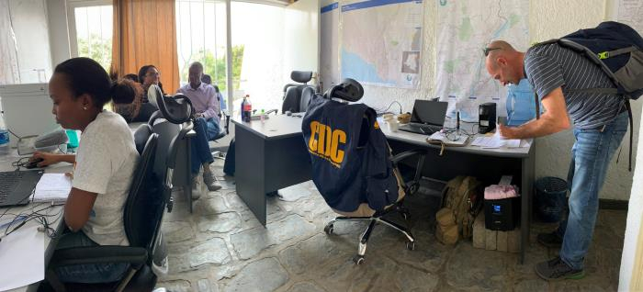
Contacts of contacts DO NOT need to isolate
Father of child confirmed with COVID-19
Whole household has to isolate (including children coming to your setting
People in setting have not had contact with the father
Other close contacts have to isolate
People who have been in contact with contact- do not isolate
Therefore they do NOT need to isolate
`
Notes:
Images from CDC PHIL

Slide 18
Scenario 3
A child who attends my setting has become unwell with COVID symptoms. The child travels to my setting on transport with pupils from the same setting who are all in different bubbles.
This is a possible case
Isolate child and advise them to get tested
Household members need to isolate
Call HPT if test comes back positive (confirmed)
Bubbles do no isolate unless the case is confirmed
Official contact tracing will not happen until the case tests positive

Slide 19
Scenario 4 A child who attends after school club has tested positive – impact for all the bubbles of the other children who attend after school provision?
Key actions:
Call the HPT on 0300 303 8162
Identify and isolate of contacts
Test those with symptoms
Clean any ‘contaminated’ areas
Communicate with parents/ others

Slide 20
Communications and media handling
The process
Local authority comms to lead on local comms - will receive regular updates from PHE comms about cases and outbreaks in education settings.
LA comms will always involve setting staff in signing off any reactive statements they are working on (or the comms lead if a university or part of an academy) as well as PHE comms.
Dealing with media approaches
Settings do not need to speak to the media – please contact your LA comms team for support.
If you do take a call from a journalist, avoid giving away too much detail or mentioning numbers of staff / pupils affected as this risks disclosing patient-identifiable information.
If media persist in contacting you, either in person, via phone or email, then the best course of action is to look to the Police for support.
Academies
If academies have their own comms teams, please make sure to link up with the LA and PHE comms team before issuing any statements.

Slide 21
Resources
NHS Resources and videos
Handwashing for teachers
Handwashing for children
Coronavirus factsheet for kids
eBug
https://e-bug.eu/
PHE webcasts for all professionals working in educational settings
Breaking the chain of infection

Slide 22
Any questions?
Please contact the health protection team:
swhpt@phe.gov.uk
Tel: 0300 303 8162

Slide 23
Extra information

Slide 24
Laundry
Use the warmest water setting and dry items completely. Dirty laundry that has been in contact with an unwell person can be washed with other people’s items.
Do not shake dirty laundry, this minimises the possibility of dispersing virus through the air.
Clean and disinfect anything used for transporting laundry with your usual products, in line with the cleaning guidance above.
People dealing with laundry from a suspected/ confirmed case should wear gloves and aprons when handling the laundry

Slide 25
Waste
Waste from people with symptoms of COVID-19, waste from cleaning of areas where they have been (including disposable cloths and tissues):
should be put in a plastic rubbish bag and tied when full
the plastic bag should then be placed in a second bin bag and tied
it should be put in a suitable and secure place and marked for
storage for 72 hours. Waste should be stored safely and securely
kept away from children
You should not put your waste in communal waste areas until the waste has
been stored for at least 72 hours. Storing for 72 hours saves unnecessary
waste movements and minimises the risk to waste operatives

